Slide 1

SECP3623 DATABASE PROGRAMMING
TOPIC 3 – ADVANCED SQL OPERATIONS 1

Slide 2
LECTURE LEARNING OUTCOME
By the end of this lecture, students should be able to:
Write DML statements to filter records in tables:
Logical operators : AND, OR, NOT
Comparison operators: =, !=, <, >, <=, >=
RANGE, BETWEEN, NULL, DISTINCT
Number functions : ROUND, TRUNCATE, MOD
String functions: UPPER, LOWER, CONCAT, SUBSTR, LENGTH
Aggregate functions : COUNT, MAX, MIN, AVG, SUM
Conditional Logic: CASE
02

Slide 3
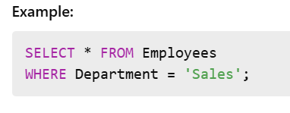
WHAT IS FILTERING?
Filtering in SQL is used to retrieve specific rows that meet certain conditions using the WHERE clause.
It helps limit query results to only the relevant data.

Slide 4
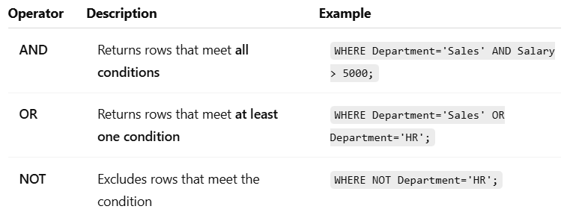
LOGICAL OPERATORS

Slide 5
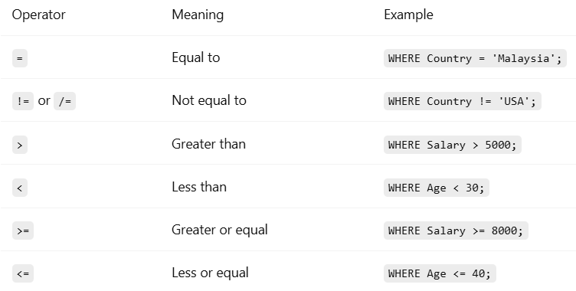
COMPARISON OPERATORS

Slide 6
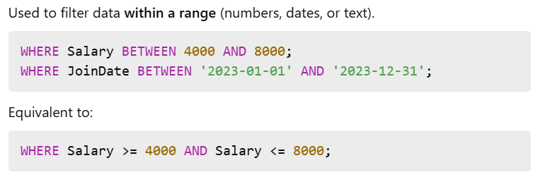
RANGE & BETWEEN

Slide 7
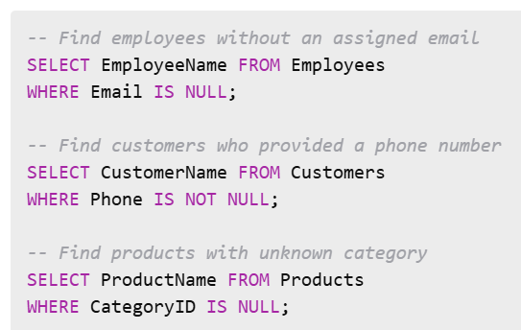
NULL
NULL means no value or unknown.
Use IS NULL or IS NOT NULL to test for missing data:

Slide 8
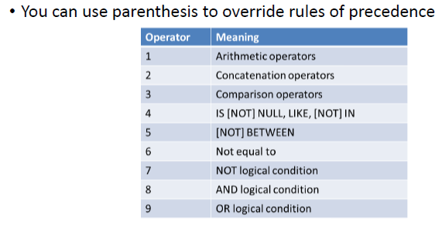
RULES OF PRECEDENCE

Slide 9
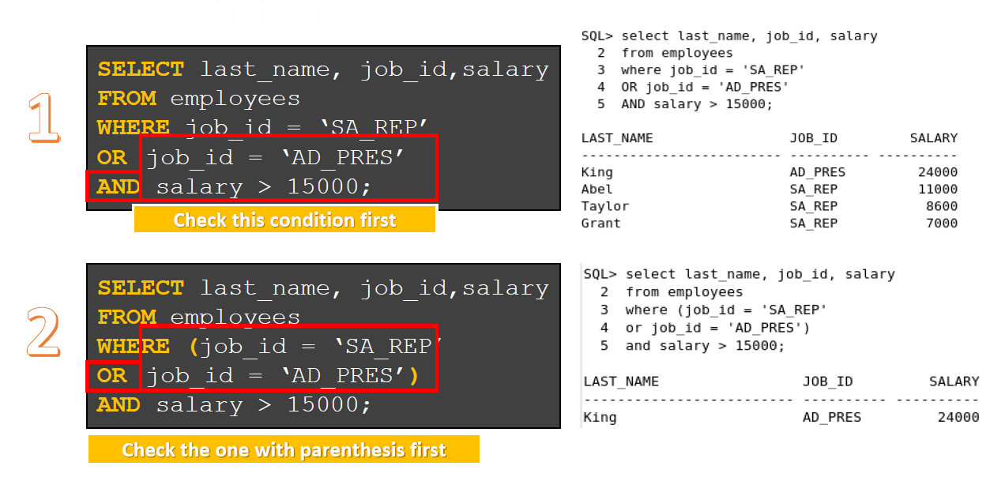
RULES OF PRECEDENCE

Slide 10
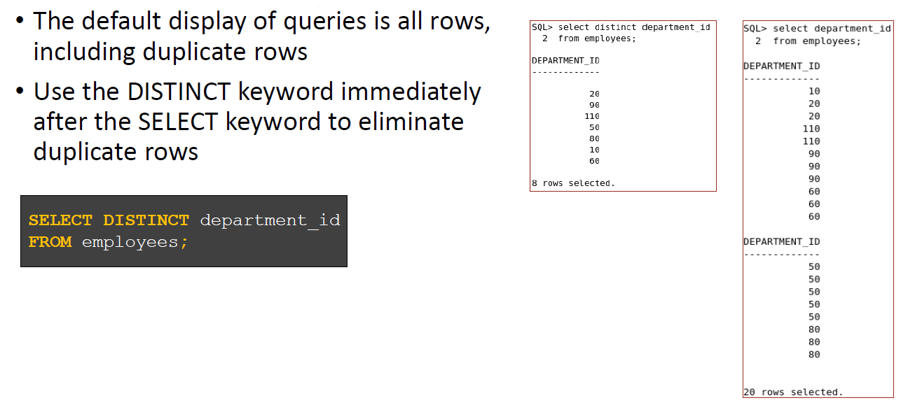
DISTINCT

Slide 11
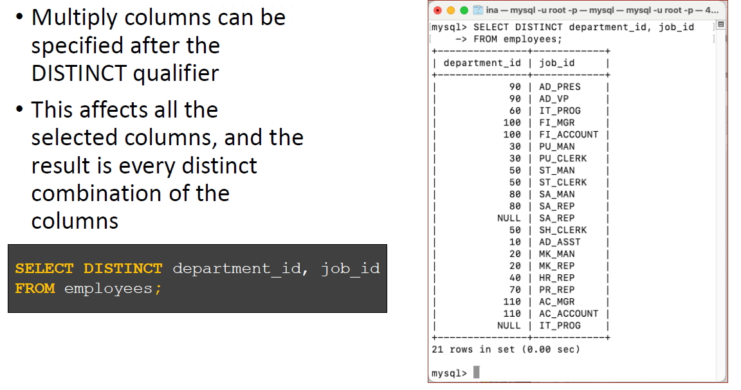
DISTINCT

Slide 12
INSERTING ROWS WITH NULL VALUES
Implicit method: Omit the column from the column list
Explicit method: Specify the NULL keyword in the VALUES clause
INSERT INTO departments (department_id, department_name)
VALUES (30, ‘Purchasing’);
INSERT INTO departments (department_id, department_name)
VALUES (30, ‘Purchasing’, NULL, NULL);
department_id | department_name | manager_id | location_id
30 | Purchasing

Slide 13
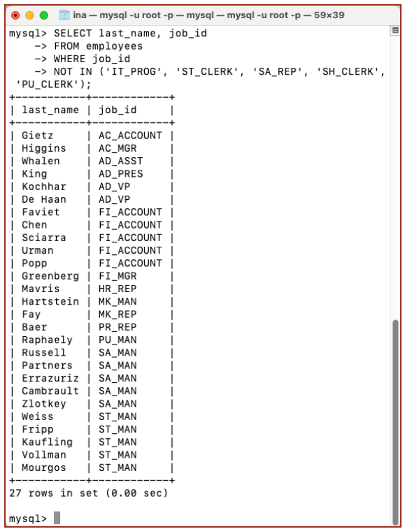
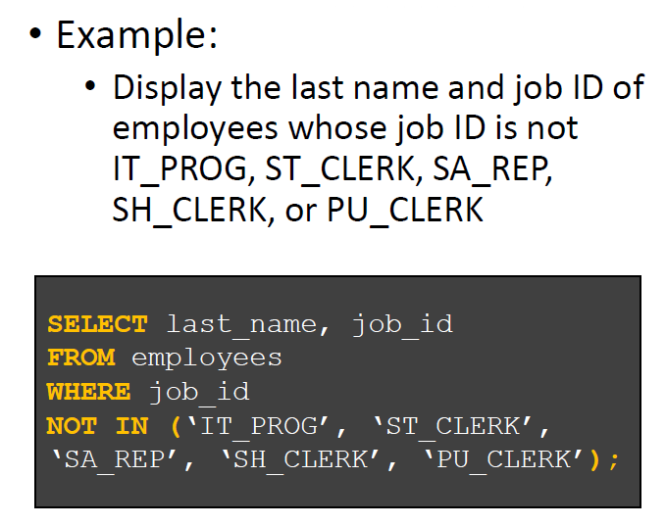
NOT OPERATOR

Slide 14
NUMERIC FUNCTIONS
ROUND: Rounds value to specified decimal
TRUNCATE: Truncates value to specified decimal
MOD: Returns remainder of division (modulus)
FUNCTION | RESULT
ROUND(45.926, 2) 1st parameter: the value 2nd parameter: number of decimal places to round | 45.93
TRUNC(45.926, 2) 1st parameter: the value 2nd parameter: number of decimal places to truncate | 45.92
MOD(1600, 300) | 100

Slide 15
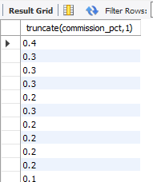
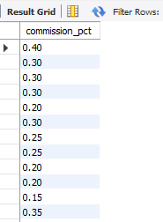
USING TRUNC (Oracle) / TRUNCATE (MySQL)
With TRUNC
Example of using TRUNC/TRUNCATE:
SELECT TRUNC(commission_pct, 1)
FROM employees
WHERE commission_pct
IS NOT NULL;
NOTE: Use TRUNCATE in MySQL
Normal data
Display normally without truncate:
SELECT commission_pct
FROM employees
WHERE commission_pct
IS NOT NULL;

Slide 16
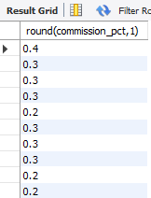
USING ROUND
With ROUND
Example of using ROUND:
SELECT ROUND(commission_pct, 1)
FROM employees
WHERE commission_pct
IS NOT NULL;
Normal data
Display normally without ROUND:
SELECT commission_pct
FROM employees
WHERE commission_pct
IS NOT NULL;

Slide 17
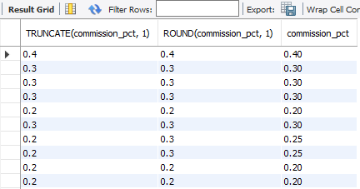
COMPARE ROUND, TRUNCATE & NORMAL
Execute the SQL statement below to see the difference
SELECT TRUNCATE (commission_pct, 1), ROUND(commission_pct, 1), commission_pct
FROM employees
WHERE commission_pct IS NOT NULL;

Slide 18
WHAT ARE STRING FUNCTIONS?
String functions are used in SQL to manipulate and transform text data.
These functions help clean, format, and extract specific information from string fields.

Slide 19
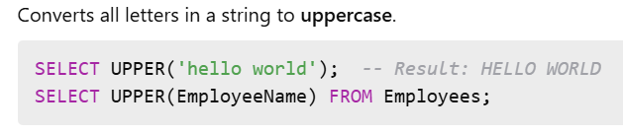
UPPER() FUNCTION

Slide 20
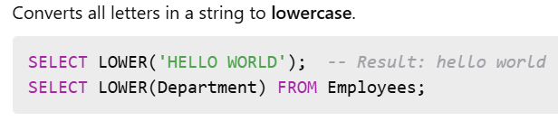
LOWER() FUNCTION

Slide 21
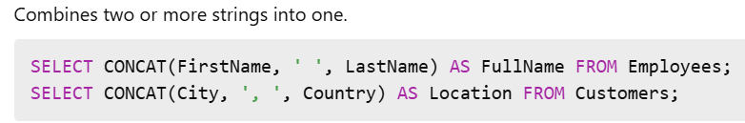
CONCAT() FUNCTION

Slide 22
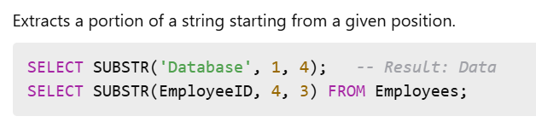
SUBSTR() FUNCTION

Slide 23
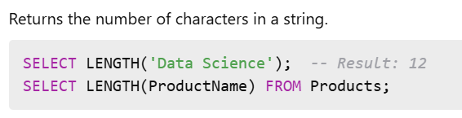
LENGTH() FUNCTION

Slide 24
AGGREGATE FUNCTIONS
Sometimes referred to as Group Functions
Can be used only in the SELECT and HAVING clause
Operate on sets of rows to give one result per group
For numeric data:
AVG - returns average of values in a column **
SUM - returns the sum of values in a column **
For numeric, character & date data types
MAX - returns the largest value of values in a column **
MIN - returns the smallest value of values in a column **
COUNT - returns number of rows
** - Ignoring NULL values

Slide 25
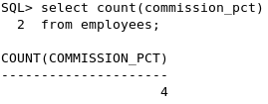
AGGREGATE FUNCTIONS
COUNT(column)
Returns the number of rows with non-null values for the column
Example:
List the total number of employees who receive commissions
SELECT COUNT(commission_pct) FROM employees;

Slide 26
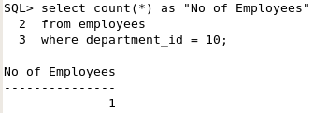
AGGREGATE FUNCTIONS
COUNT(*)
Return number of records (rows) in the table
Includes duplicate rows and rows with NULL values
Example:
List the total number of employees in department number 10.
SELECT COUNT(*) AS “No of Employees”
FROM employees
WHERE department_id = 10;

Slide 27
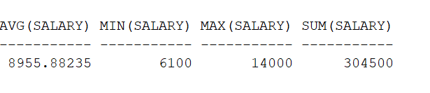
AGGREGATE FUNCTIONS
Example:
List the average, sum, minimum and maximum salary for employees in department number 80.
Department number 80 has 34 employees
SELECT AVG(salary),MIN(salary),MAX(salary),SUM(salary)
FROM employees
WHERE department_id=80;

Slide 28
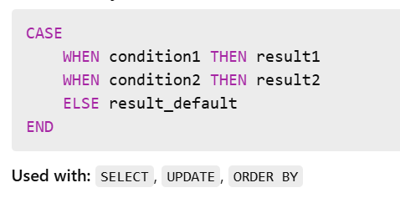
WHAT IS CONDITIONAL LOGIC (CASE)?
The CASE statement is used to apply conditional logic in SQL queries.
It allows you to perform if-then-else operations directly within your SELECT, UPDATE, or ORDER BY clauses.
Purpose:
Add logic-based output to your results.
Replace numeric or coded data with readable text.
Categorize data dynamically.

Slide 29
CONDITIONAL LOGIC (CASE)
CASE stops checking once a true condition is found.
Can be nested inside other SQL functions.
Useful for data transformation during reporting.

Slide 30
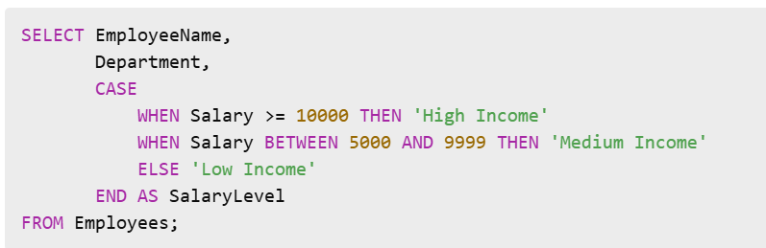
EXAMPLE: SIMPLE CASE IN SELECT

Slide 31
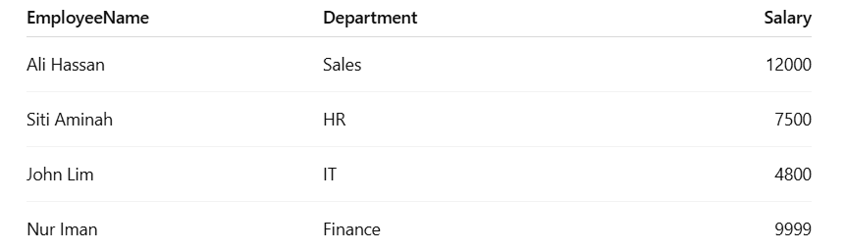
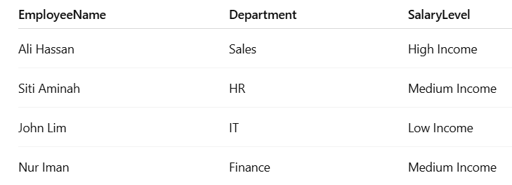
INPUT:
OUTPUT:

Slide 32
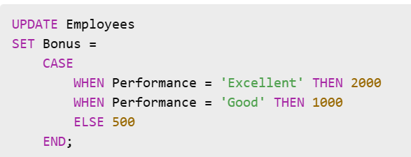
EXAMPLE: CASE WITH UPDATE

Slide 33
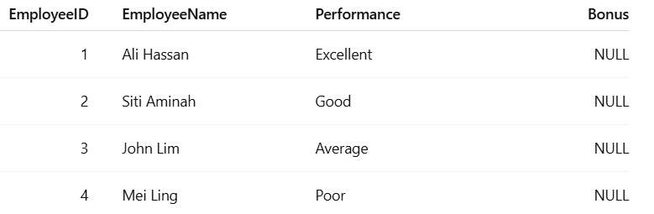
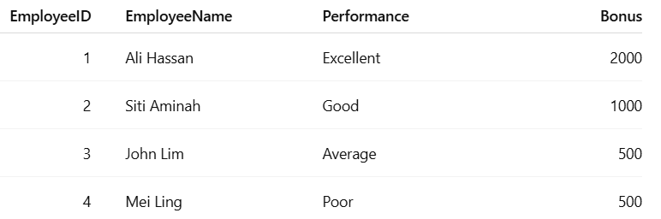
INPUT:
OUTPUT:

Slide 34
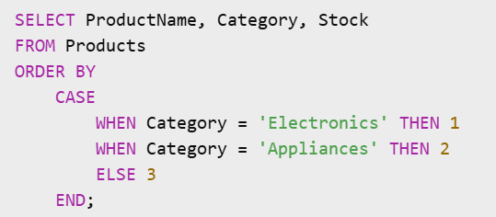
EXAMPLE: CASE IN ORDER BY

Slide 35
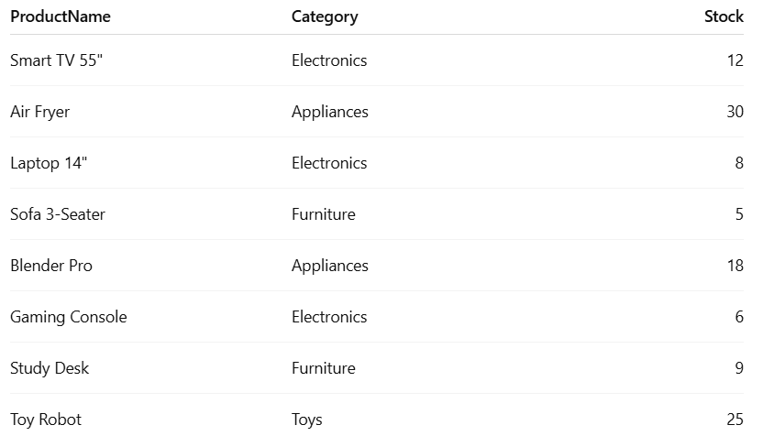
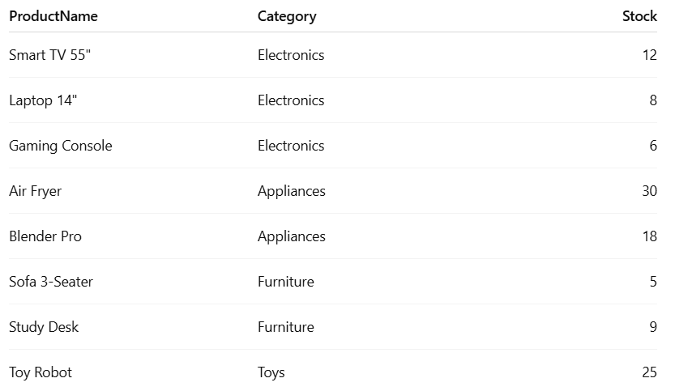
INPUT:
OUTPUT:

Slide 36
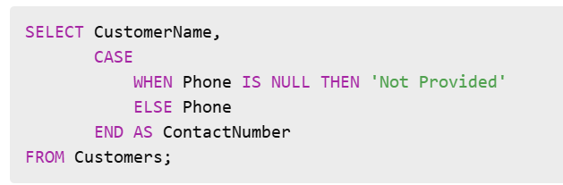
REPLACE NULL VALUES WITH CASE

Slide 37
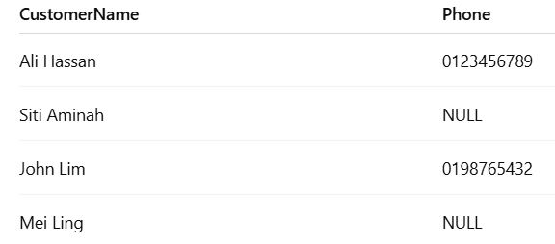
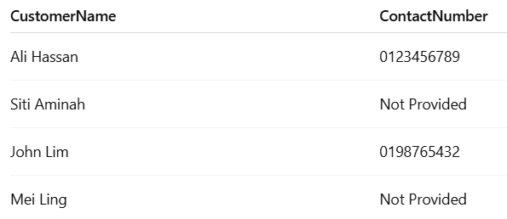
INPUT:
OUTPUT:

Slide 38
SUMMARY
Logical operators : AND, OR, NOT
Comparison operators: =, !=, <, >, <=, >=
RANGE, BETWEEN, NULL, DISTINCT
Number functions : ROUND, TRUNCATE, MOD
String functions: UPPER, LOWER, CONCAT, SUBSTR, LENGTH
Aggregate functions : COUNT, MAX, MIN, AVG, SUM
Conditional Logic: CASE

Slide 39


